Slide 1
Cricket Wales Survey 2020
All Wales

Slide 2
Responses from areas of Wales

Slide 3
Leagues you play most of your cricket

Slide 4
Positions held in club cricket

Slide 5
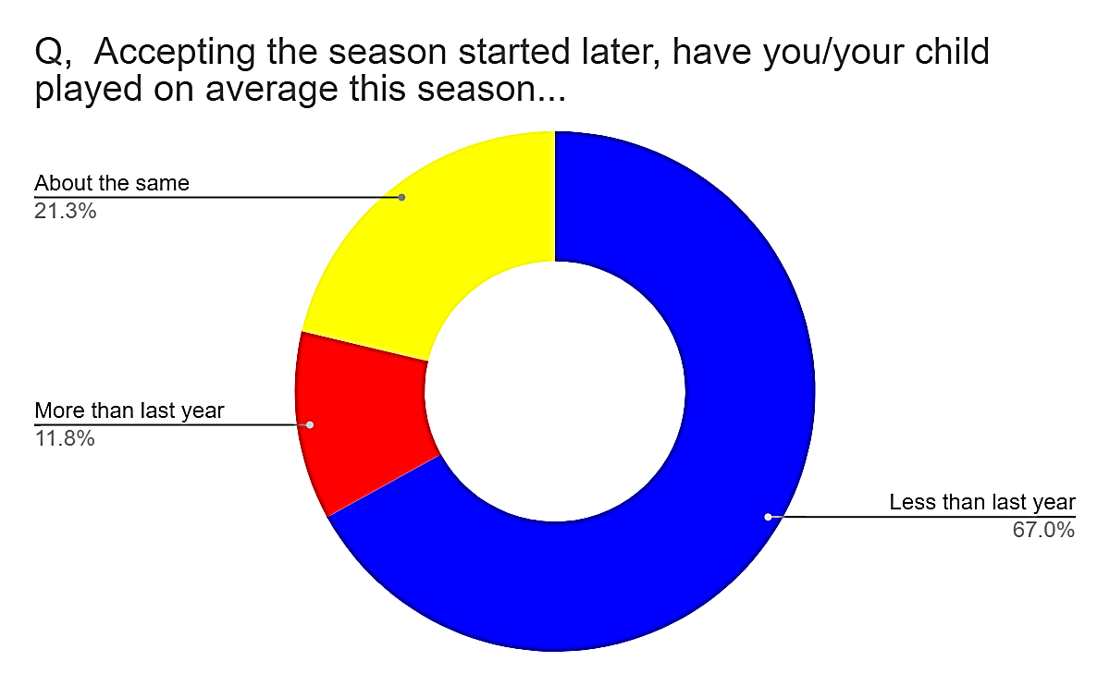
Level of cricket & amount played this season

Slide 6
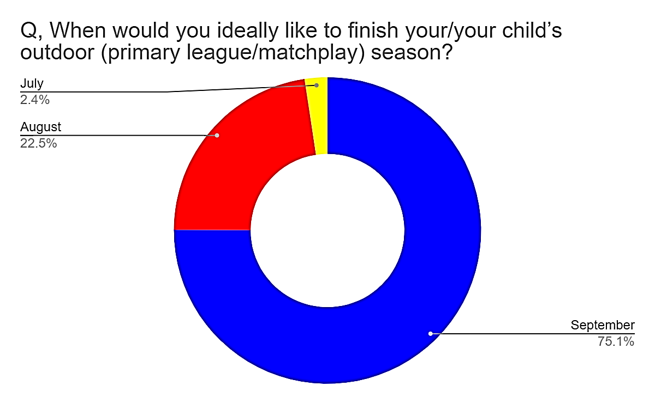
When responders would like to start & finish an ideal season

Slide 7
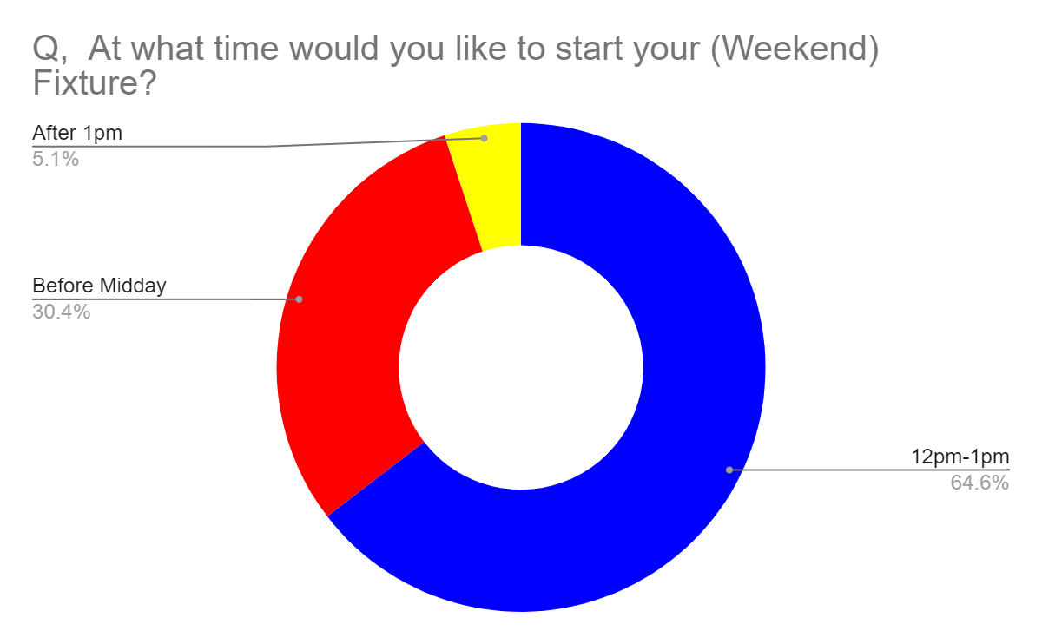
Format & start time

Slide 8
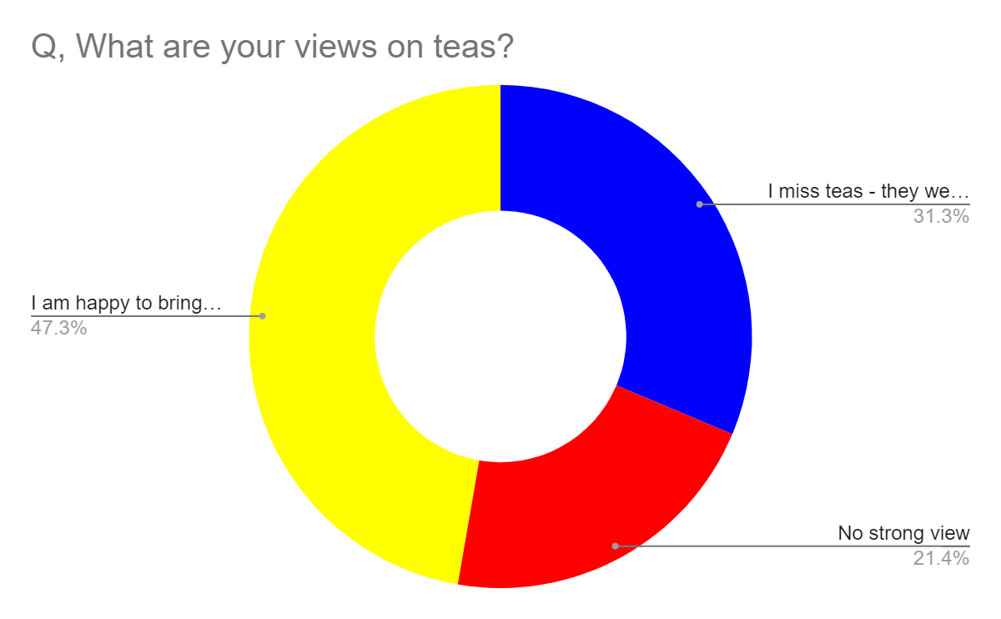
Kit & teas views

Slide 9
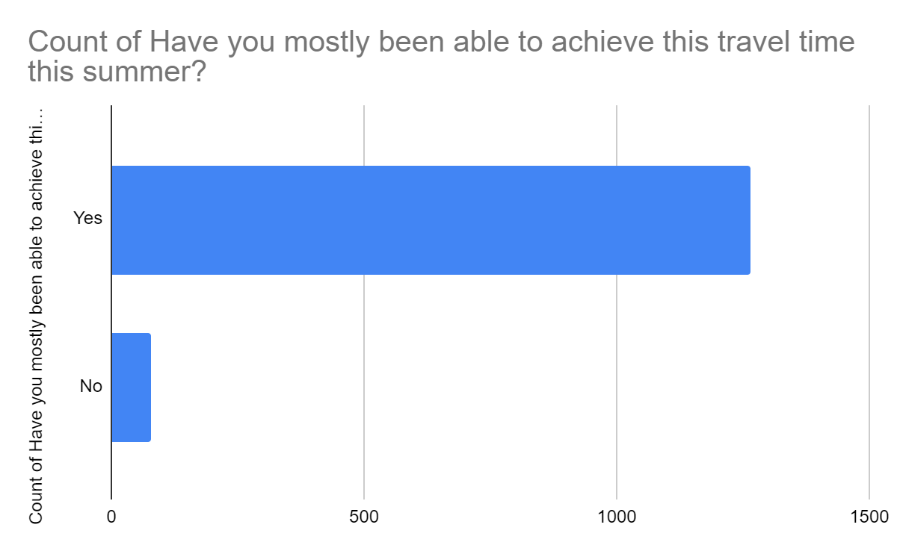
Travel time to fixtures

Slide 10
Thank you to everyone who took the time to respond, we will work closely with the league and drill down on the key themes. If you would like more information of the data please contact your area manager

