Slide 1
Cricket Wales Survey 2020
South Wales Cricket Association

Slide 2
Detail of the responders of the survey
125 responses who affiliate themselves to SWCA ranging from 34 clubs
110 of the responses were form players (98%)
20 of the responders were captains
11 represent U18 players
17 represent volunteers (Chairperson, coach CWO)
6 responses form Umpires/scorers
9 % said they had played more than 2019 season
13 % said they played about the same
78 % played less than 2019 season

Slide 3
Standard of players played the majority of cricket in 2020 season.

Slide 4
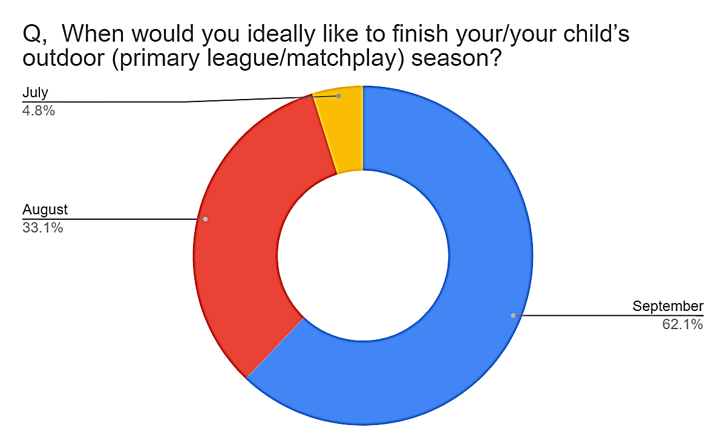
Preferred start & Finish times of the Season

Slide 5
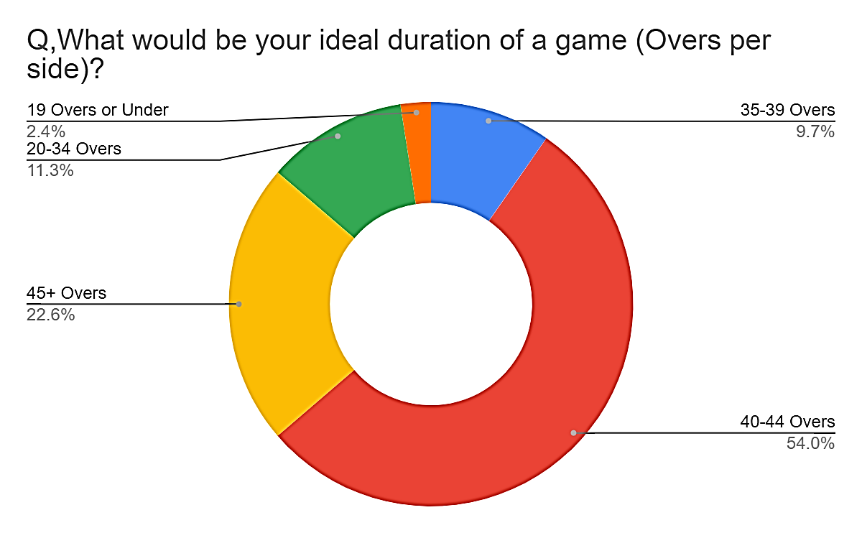
Format/duration & Match start times

Slide 6
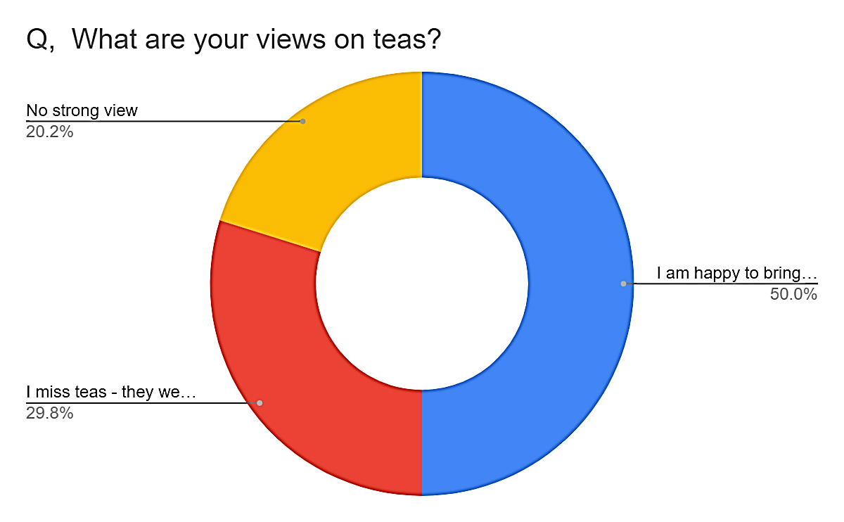
Views on Cricket clothing & Teas

Slide 7
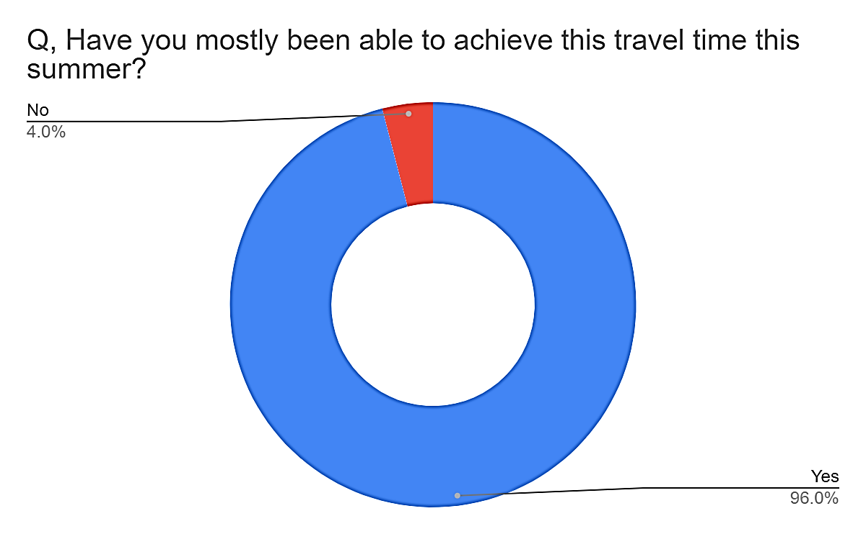
Distance, travel times to games

Slide 8
What suggestions do you have for how your league could make your cricket more competitive (if you are not currently satisfied with this)?
More tournaments accessible by lower tier sides, potentially winning silverware
Bigger league where everyone plays each other once. 20 game season.
power plays & free hit
Super overs and free hits
Allocated umpires for all league games would be of benefit, although understand Sustainability would be difficult.
I think the leagues are competitive enough under normal circumstances
Bring back overseas/professionals. Get a Glamorgan academy side into the leagues. Mimic the leagues above power plays etc. Introduce own league T20 competition or veterans league on Sundays.
Playoffs for promotion/relegation
3 teams up n down , keeps all involved to last game

